Slide 1
Timp lab rotation
Fall 2023
Daniel Rabizadeh

Slide 2
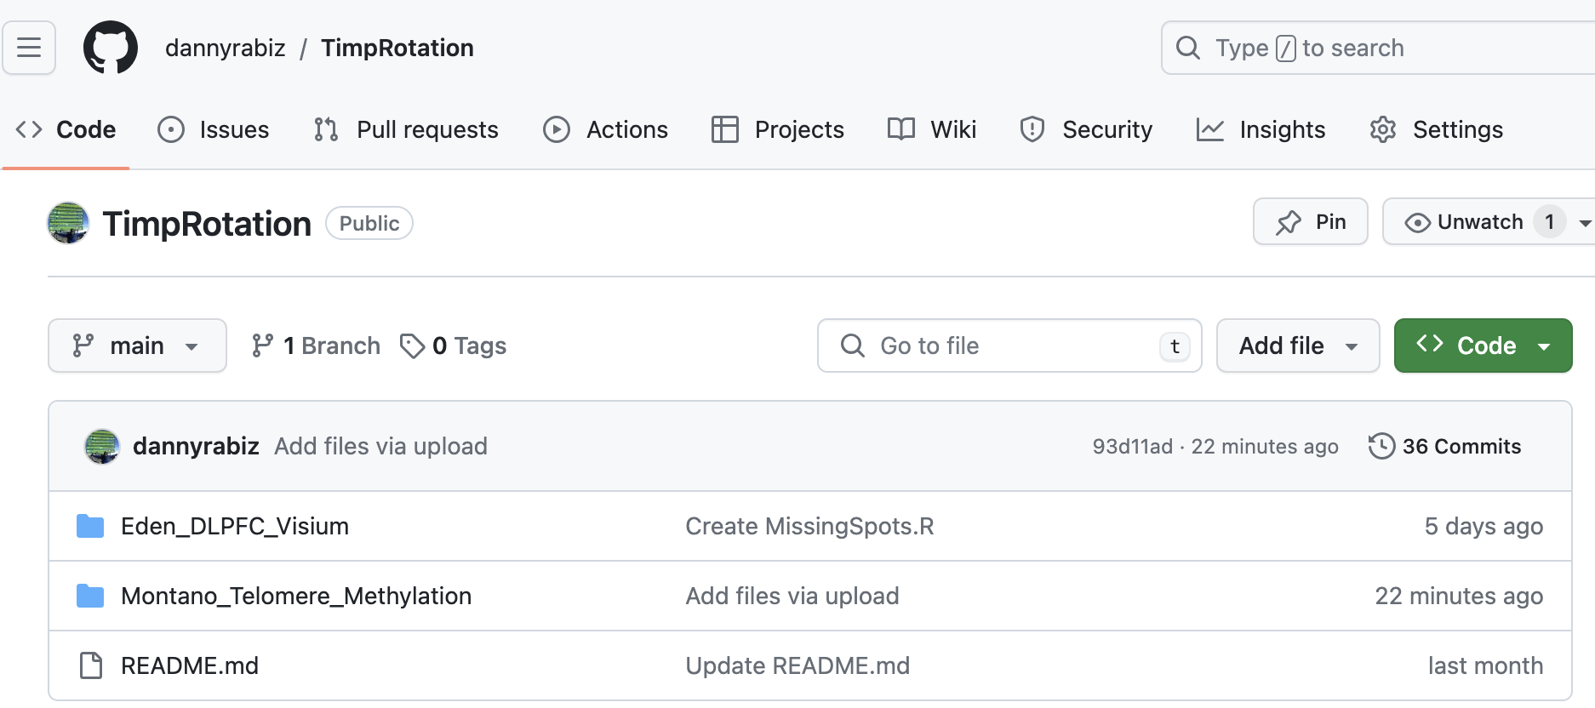
Where everything is:
scripts/figures/notes: Github: https://github.com/dannyrabiz/TimpRotation
all scripts including the bad ones: drabiza@whack: /home/drabiza
Large files (bams/pod5 etc.): drabiza@wilee:/Data/drabiza1/

Slide 3
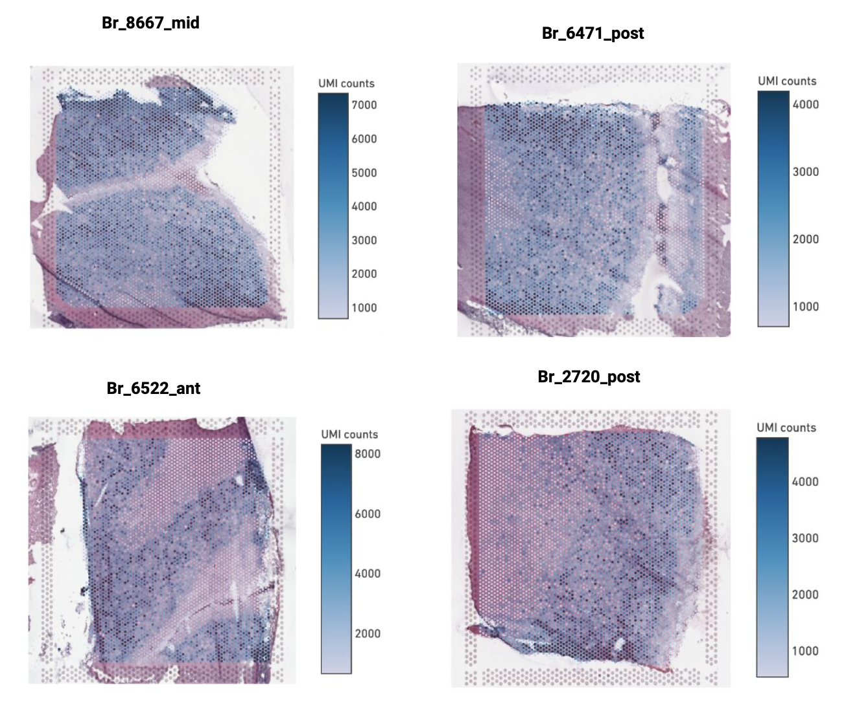
Spatial transcriptomic characterization of human brain tissue with single molecule resolution
Project led by Hope
Where I started: Hope optimized and run all the sequencing protocol + QC + Preprocessing of count matrix
What needed to be done:
1. Spatial Clustering
2. Comparative isoform expression
3. Novel isoform detection?
Source: Hope’s Thesis meeting slides

Slide 4
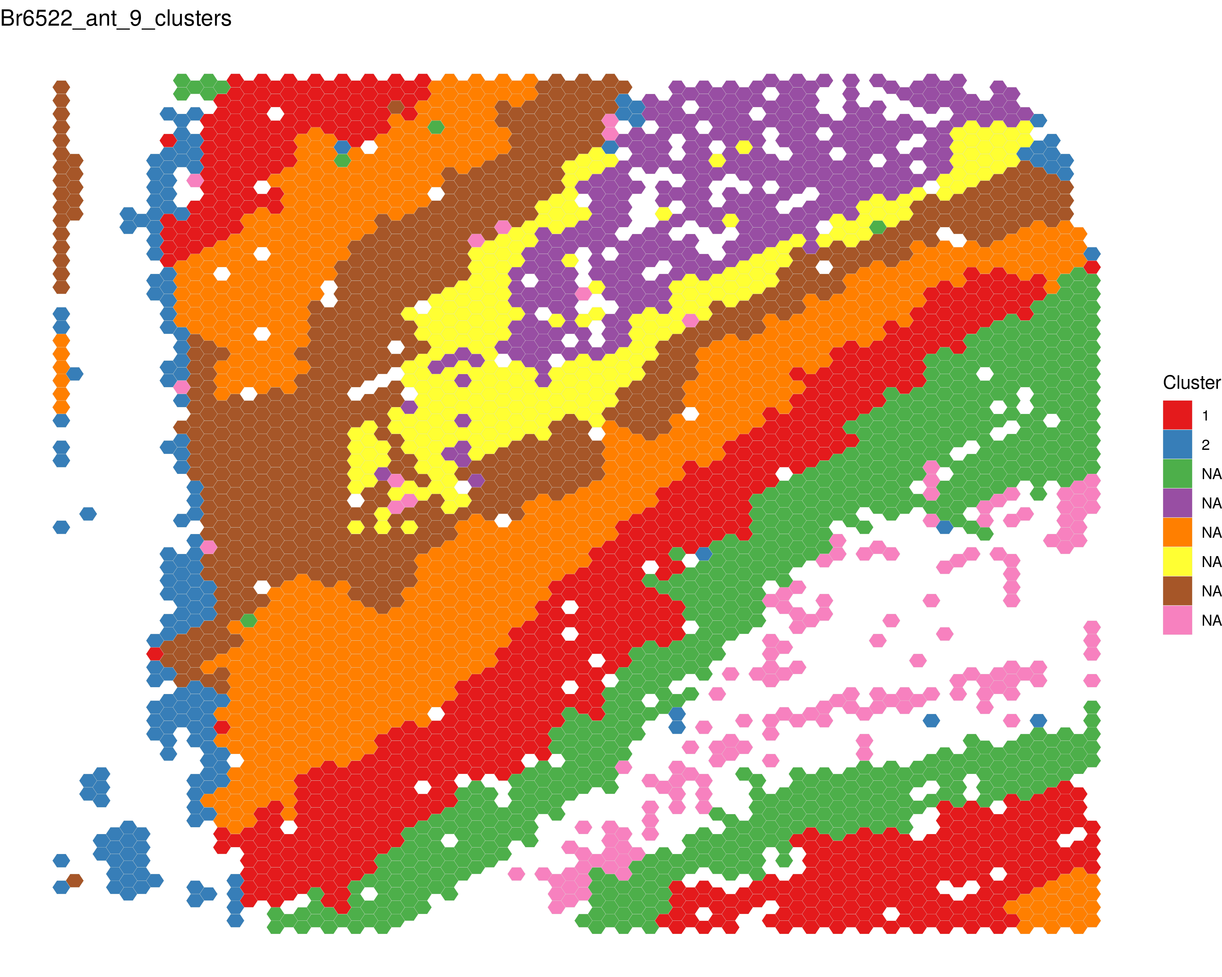
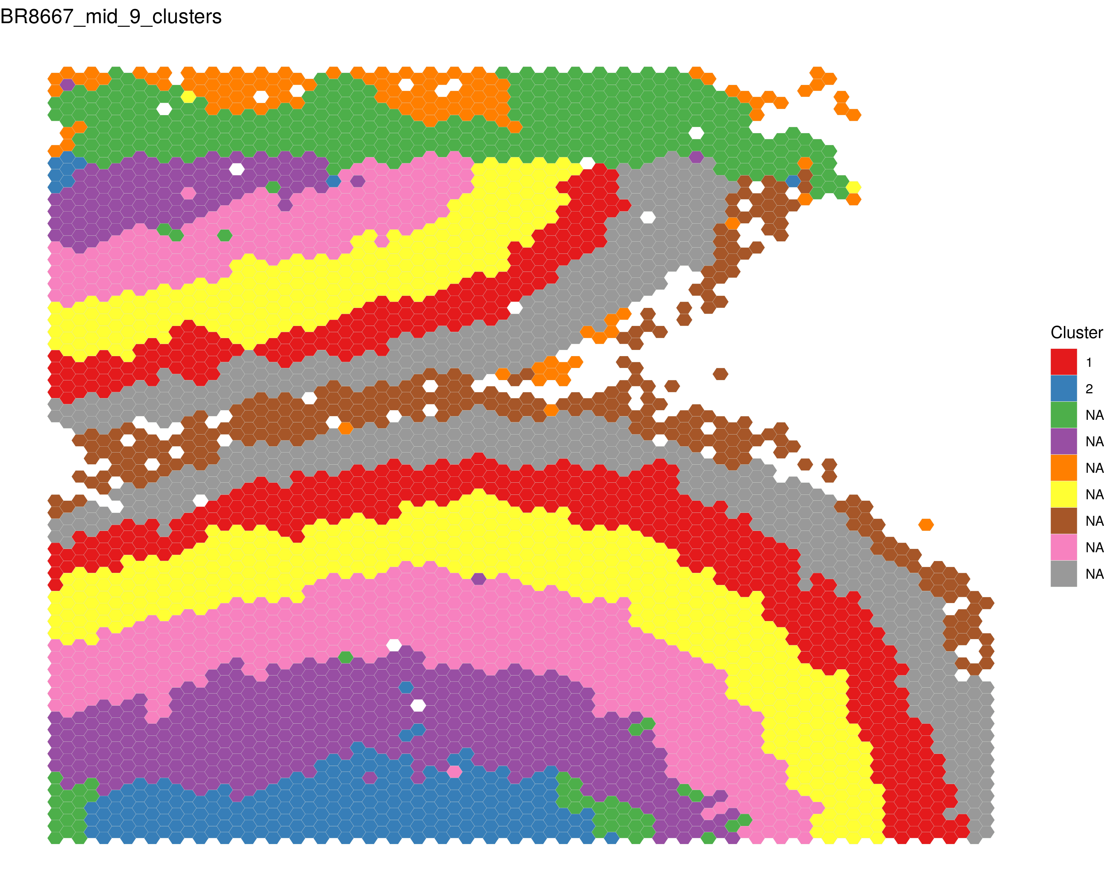
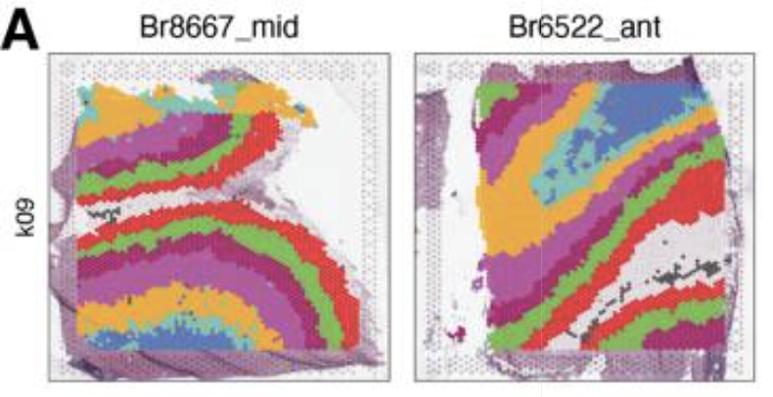
Clustering with BayesSpace
Br6522
Br8667
Nanopore:
- Data looks good compared with Illumina
- Bayesspace prefers 6/7 clusters but we wanted 9 clusters
Illumina:

Slide 5
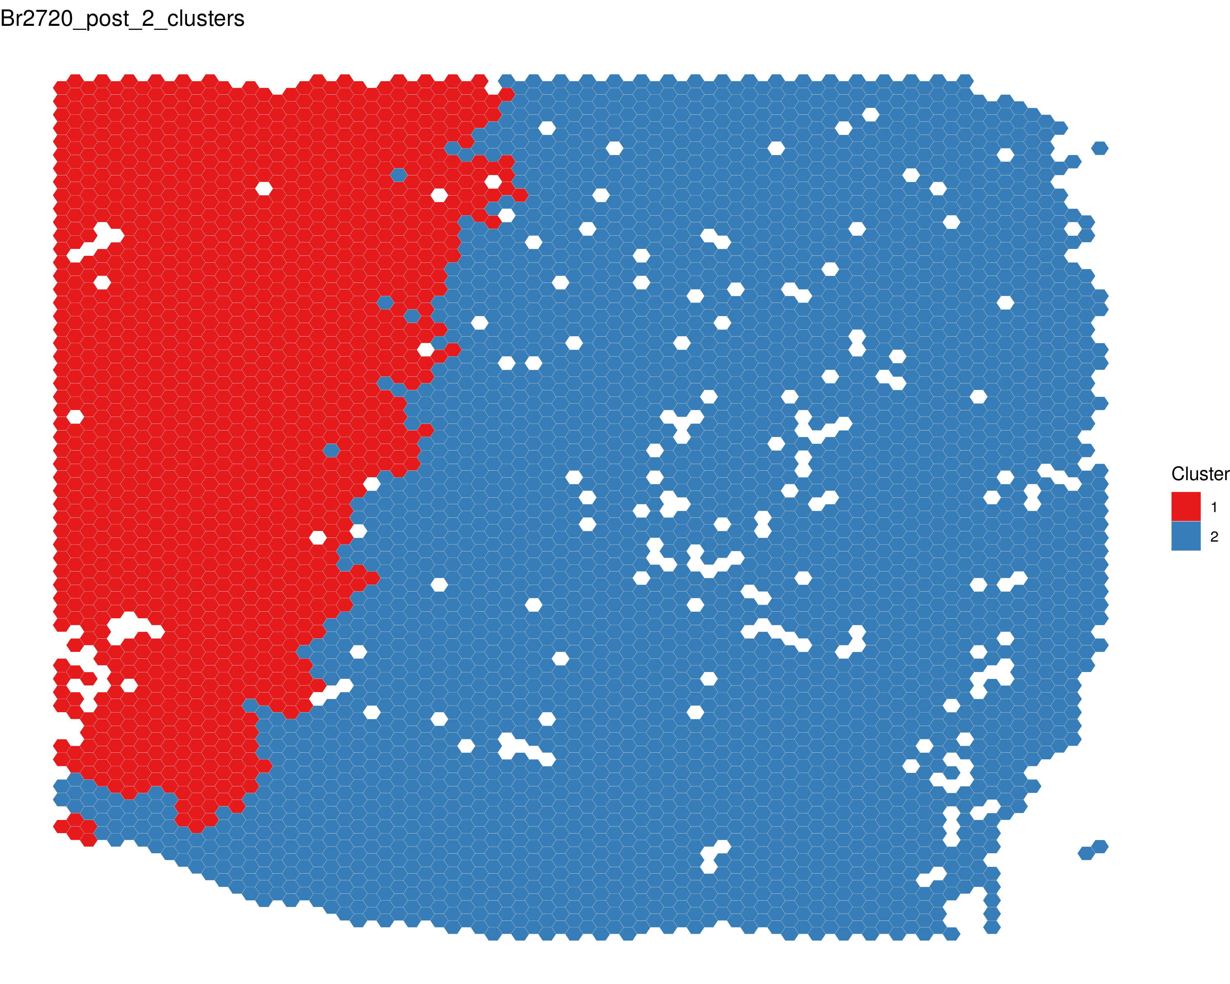
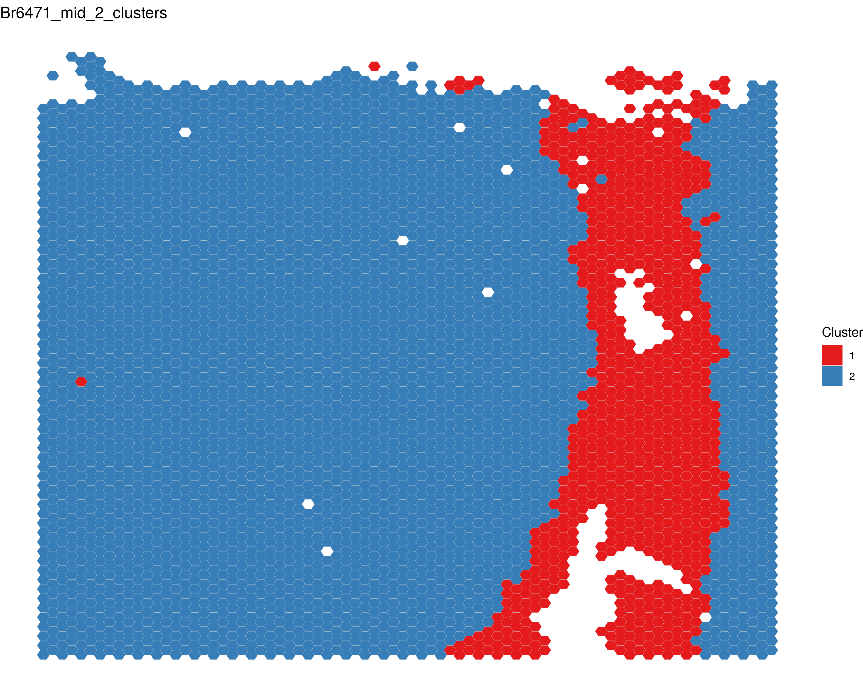
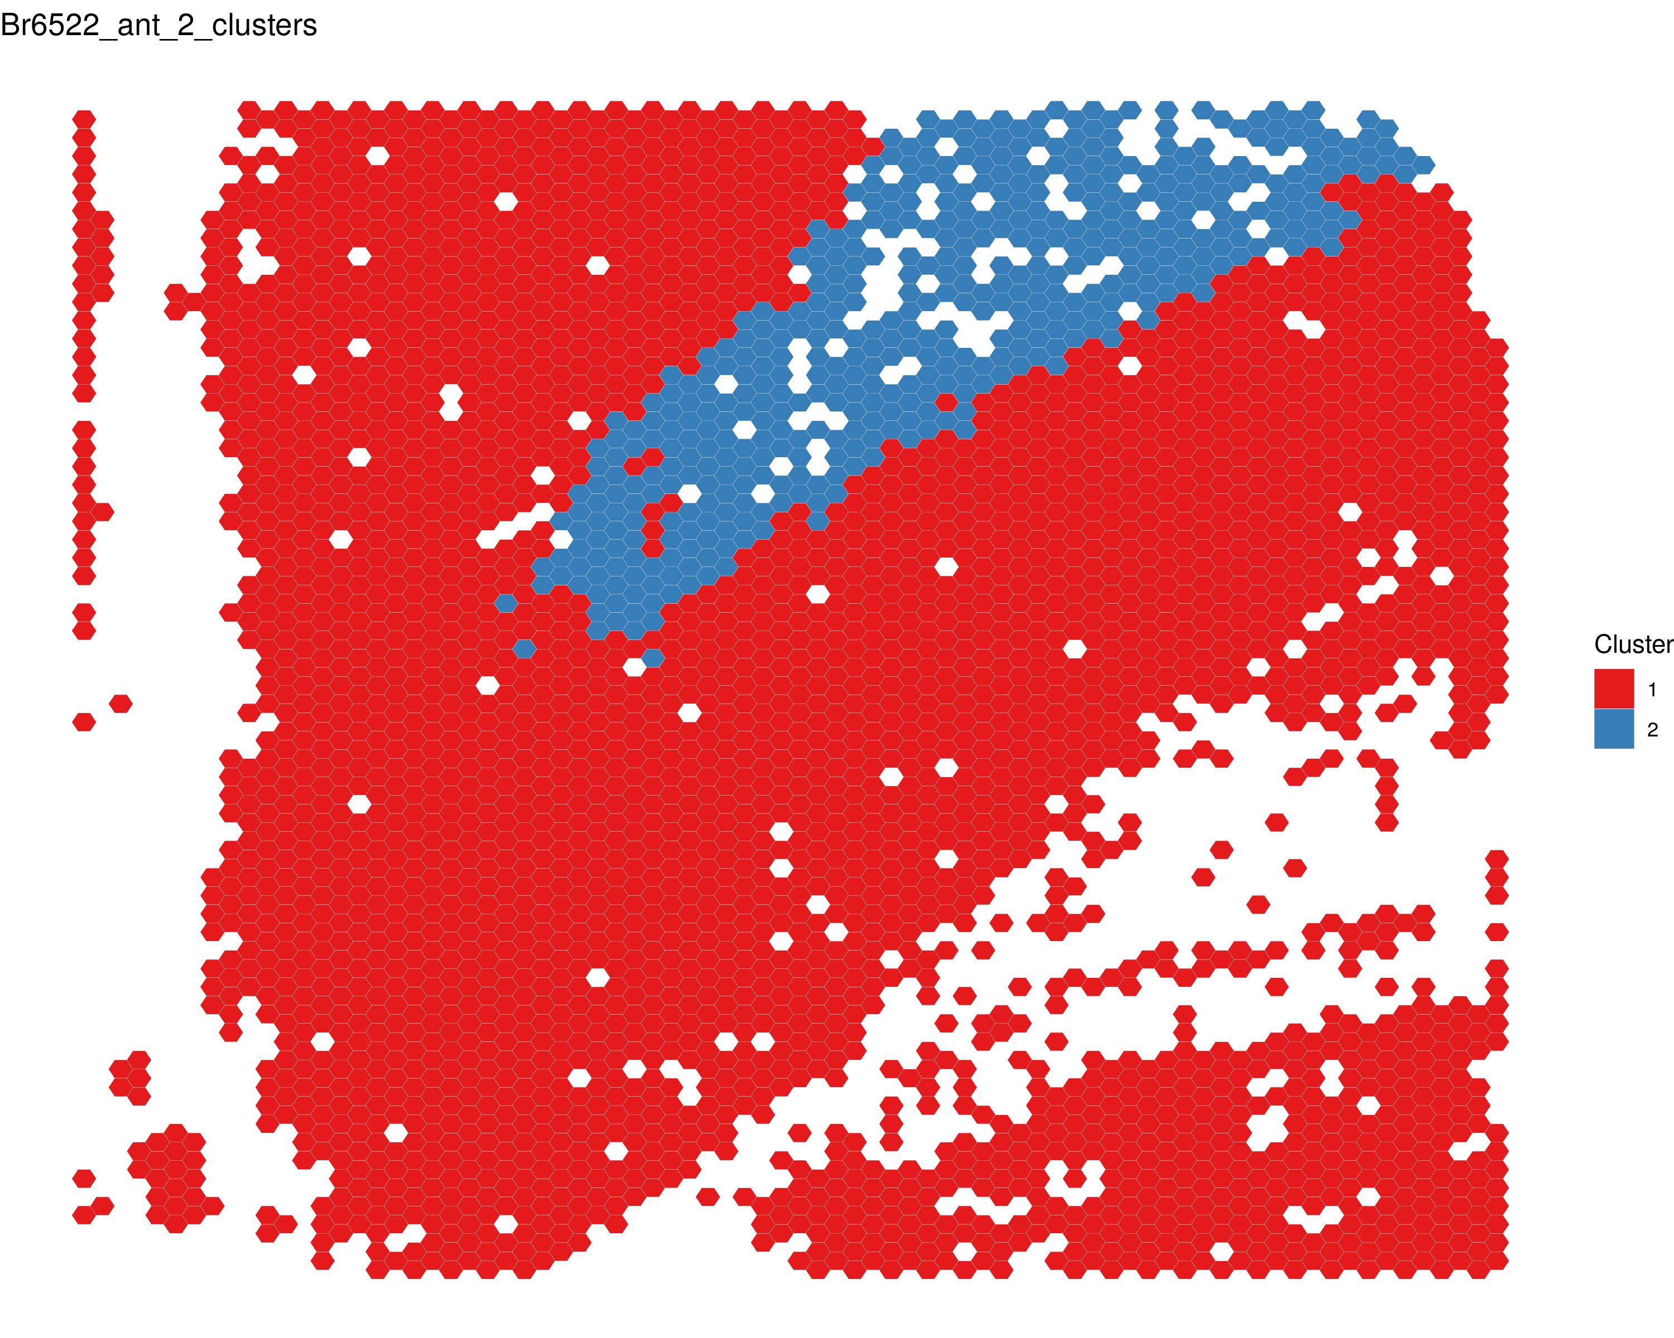
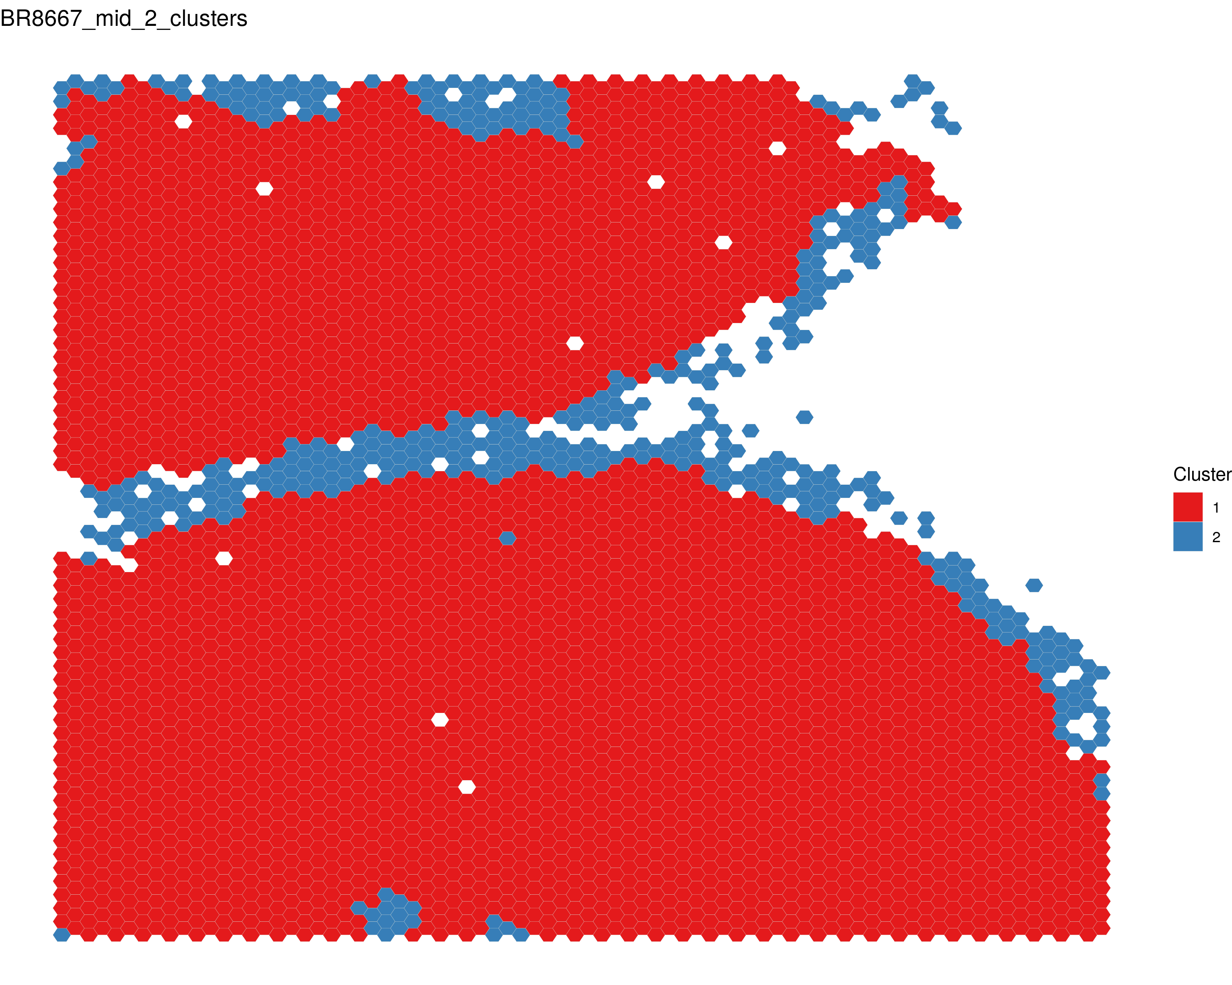
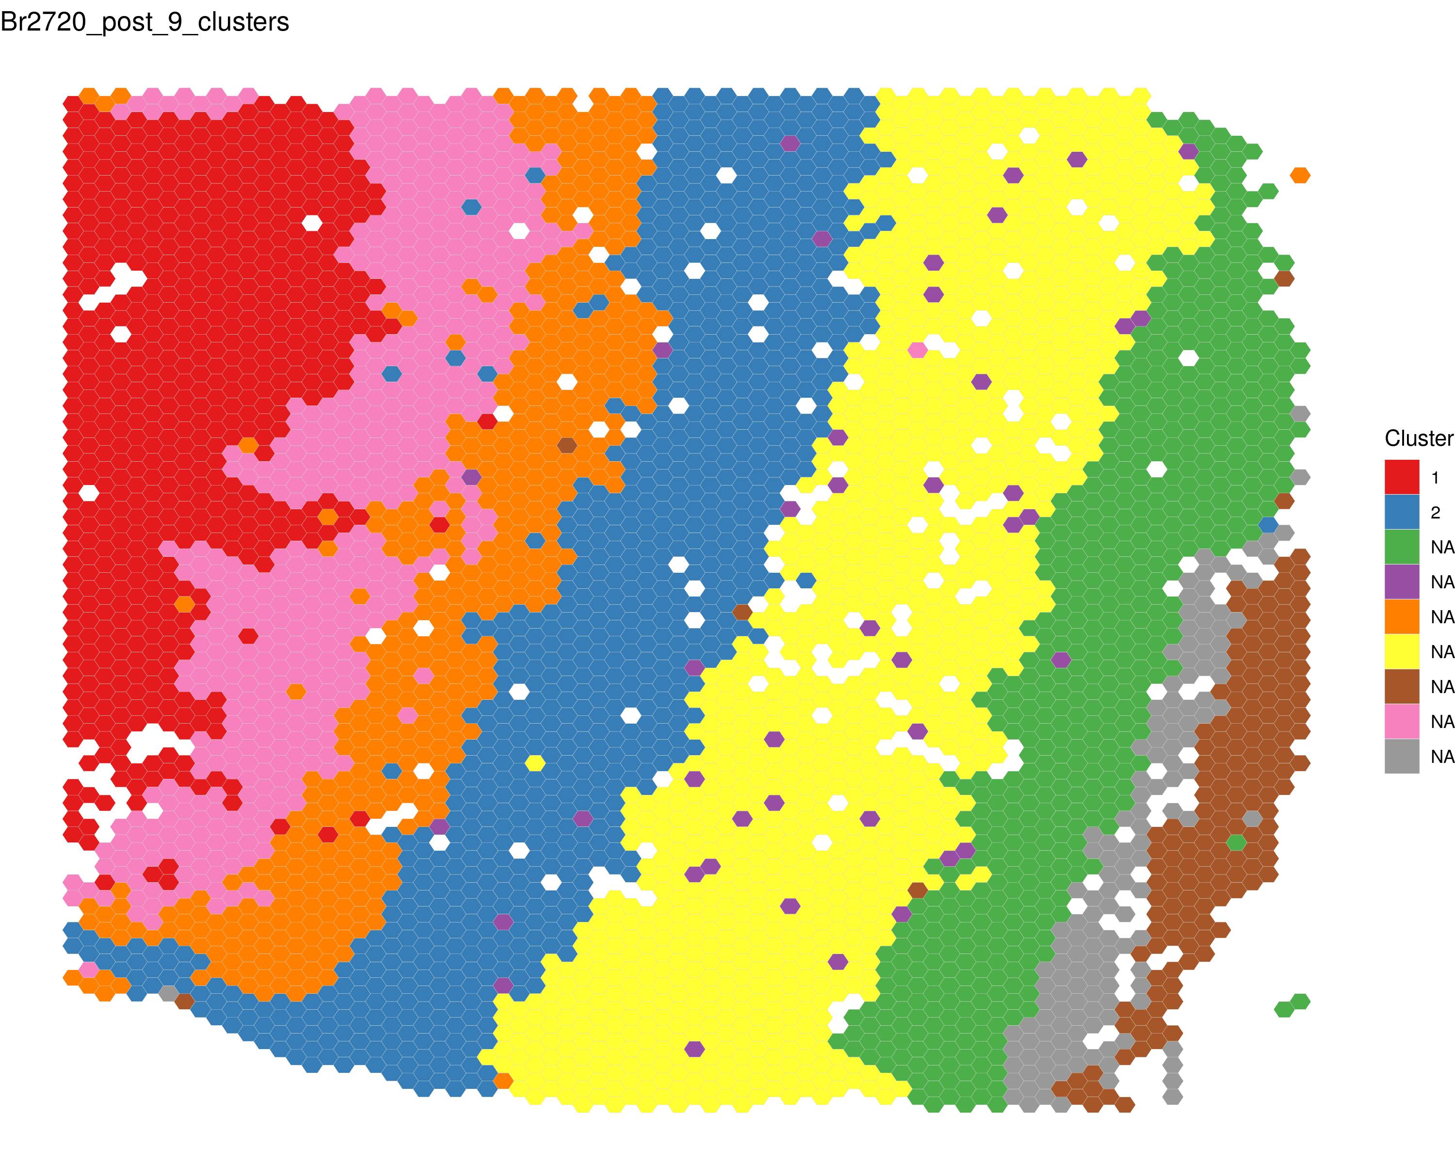
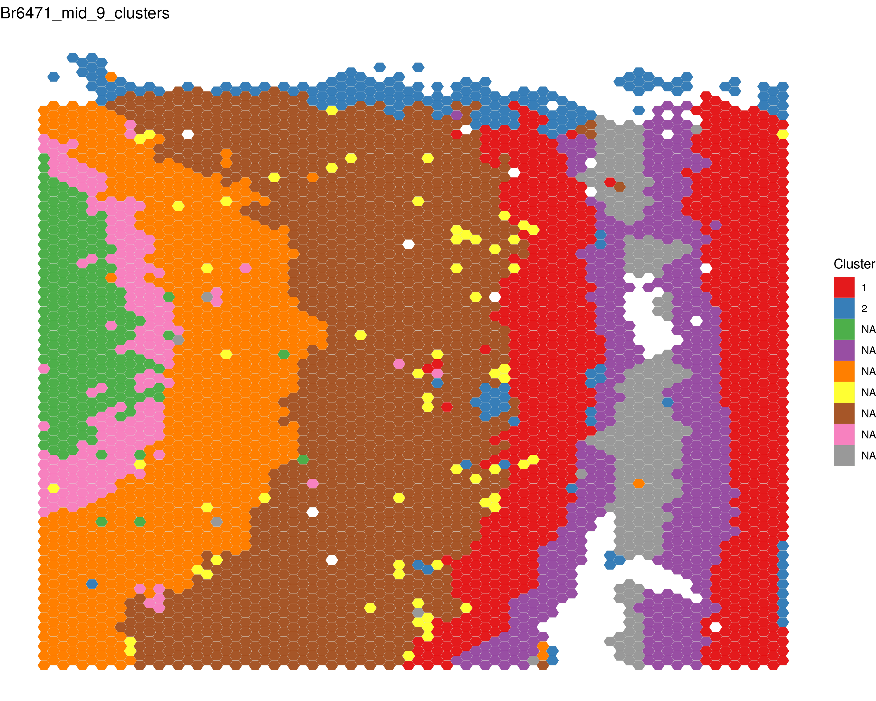
2 clusters vs 9 clusters
Br2720
Br6471
Br6522
Br8667

Slide 6
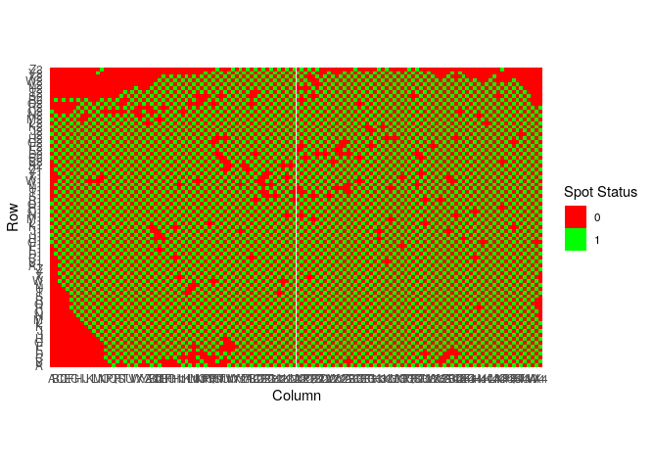
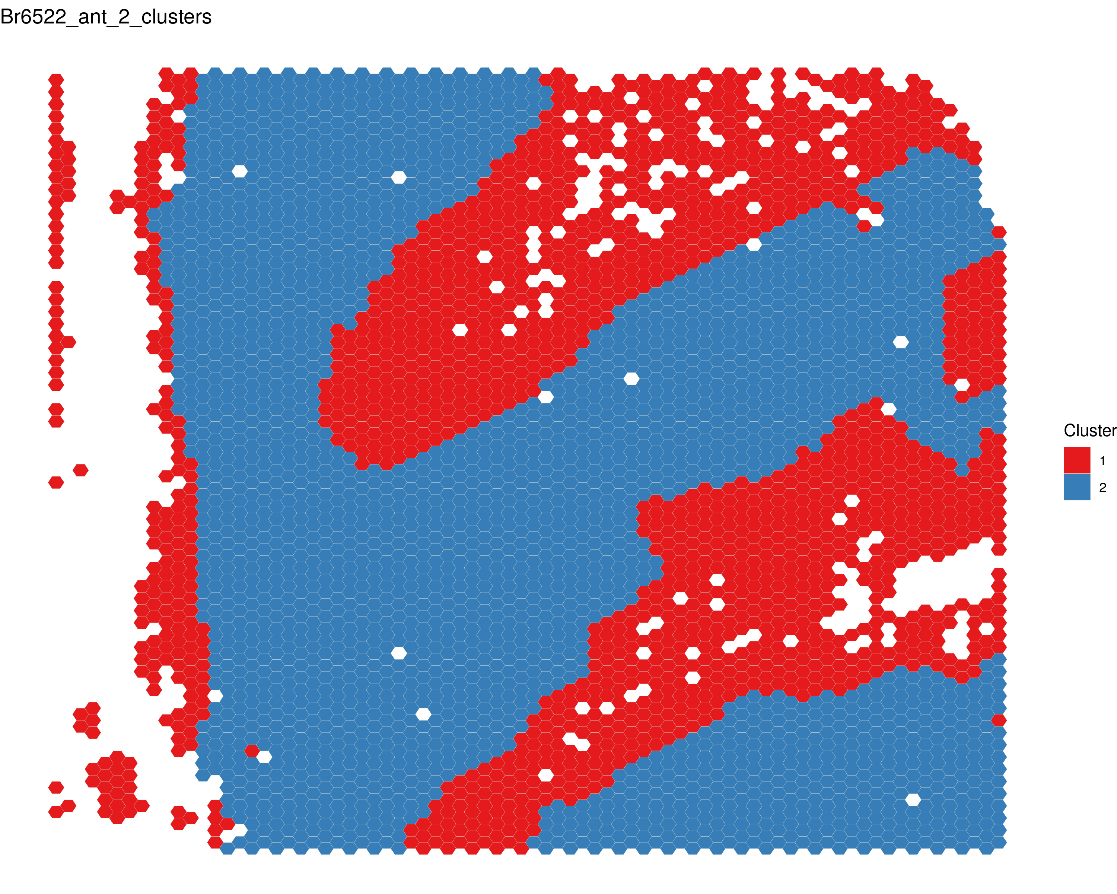
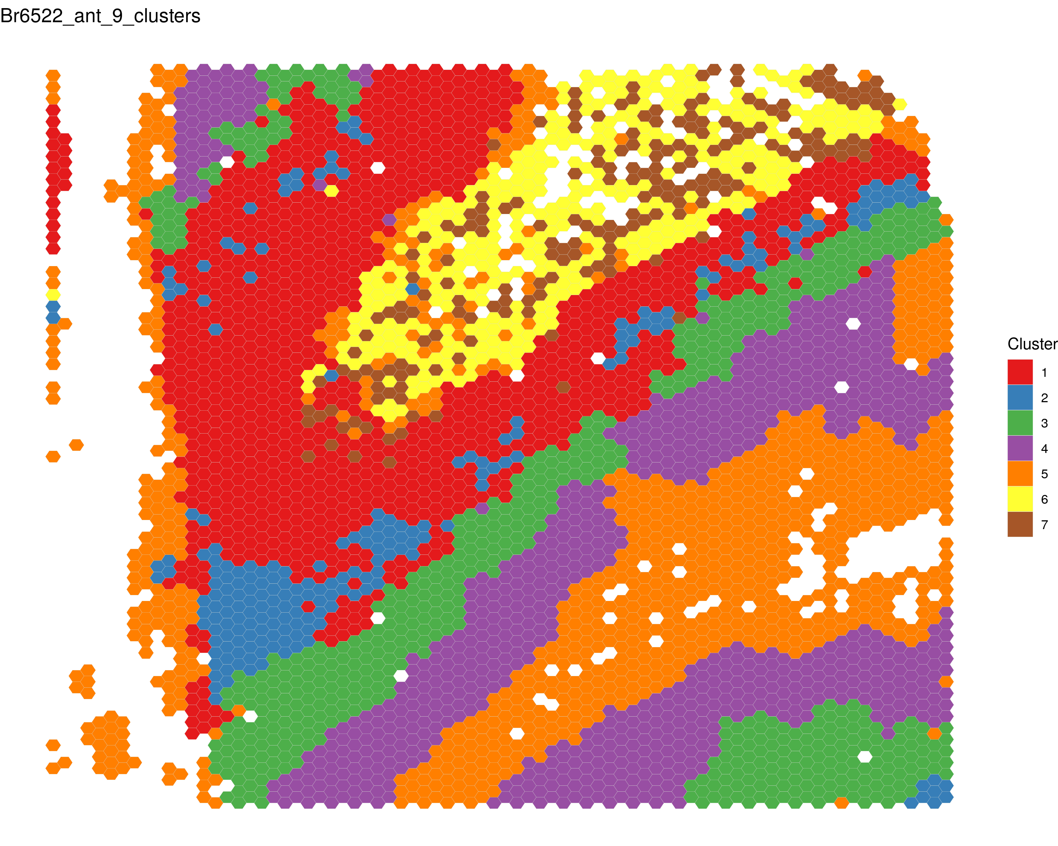
Why are spots not getting clustered?
Mapping of barcode coordinates
Sockeye Filtering:
Filter out barcodes with fewer than 25 reads
Filter out barcodes with >20% MT reads
Some clusters much more likely to have rate of MT reads
K=2
Removing filter
Clearly low quality, shows very poor clustering
Removing filter
K=9
Notes:
Should we be focusing on utilizing these low quality or are we fine removing them?

Slide 7
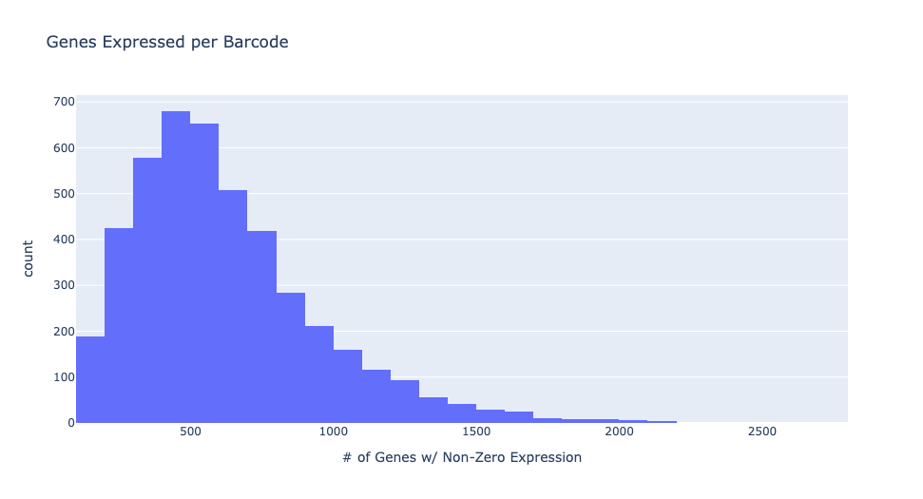
DE analysis
What would be the best approach?
Sheridan/Seurat approach – treat each spot as a separate data point
Pseudobulking – join all spots from the same cluster together
- How would we join clusters across samples
Pseudo-bulking test run:
Gray Matter vs White Matter across 4 samples:
Variation in spot quality

Slide 8
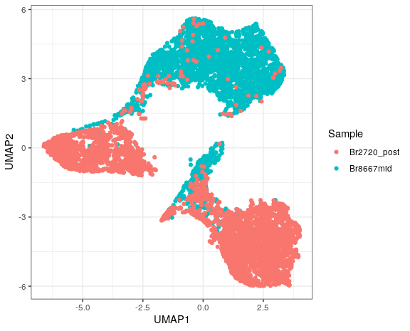
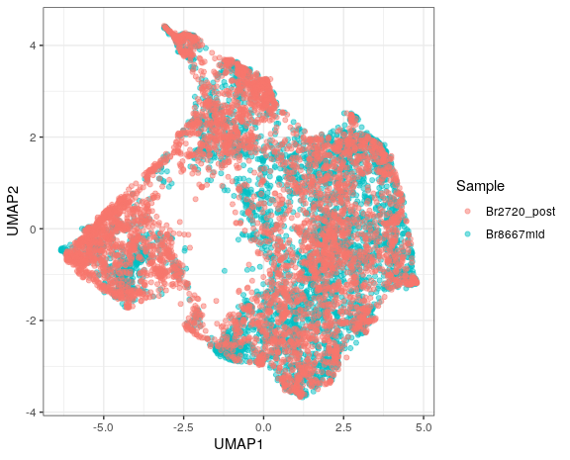
Dealing with Batch effects/technical differences across samples
Harmony

Slide 9
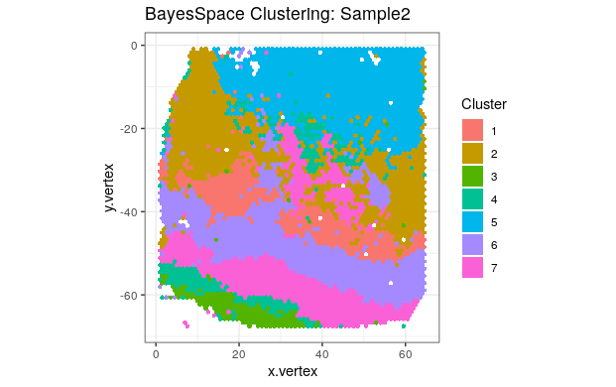
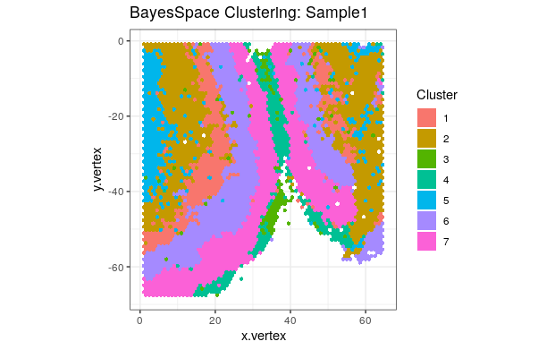
Joint-clustering works well
Now that we have cluster labels consistent across sample:
Output from R the cluster assignments
Go back to bam files and re-organize into new files based on cluster
Run DE on 4x4 across the 9 clusters

Slide 10
Current Hiccups and Future steps
Joint clustering with all 4 samples giving me an unknown error: Spectral initialization failed to converge, using random initialization instead
Still don’t have a clear gameplan on demonstrating a comparison between Illumina
Should we use a different clustering algorithm all together
My unpopular opinion: Don’t give up on novel transcript detection.
Now that we can compare across all 4 samples we can create a pipeline that will exclude a lot of false-positives.
Filter down to putative novel isoforms that have a consistent pattern of expression when comparing across clusters.
At this point you can incorporate Illumina/Gencode data and look for discrepancies.

